Slide 1
TMF Technology Trends: Insights from TMF Data
Jim Horstmann, Senior Product Manager Veeva eTMF
14-May-2025

Slide 2
TMF Technology Trends: Insights from TMF Data
Jim Horstmann, Senior Product Manager Veeva eTMF
Veeva Systems

Slide 3

Meet the Speaker
Jim Horstmann
Title: Senior Product Manager, Veeva eTMF
Organization: Veeva Systems
Jim has spent his career working on document management solutions for the Life Sciences industry with the last 13 years focused on eTMF applications. Jim is driven by finding ways to make processes more efficient and to improve user experiences to ultimately make managing TMF documentation easier and to increase the quality of the TMF. Additionally, Jim is interested in how new technologies and insights into data can be leveraged to innovate and drive the industry forward.
Notes:
The Session Chair will introduce you based on the information you provide on this slide.
Instructions:
1. Select one of the two ‘Meet the Speaker’ templates based upon how many presenters you have.
2. Insert a medium or high resolution professional bio photo of yourself and format it to the dimensions of the placeholder image(s).
3. Place bio photo(s) over the placeholder(s) and delete the placeholder image(s).
4. Fill in your name, title and organization in the text boxes provided.
5. Insert short bio’s in the text box provided. If the quantity of presenters does not allow adequate space for bios on the slide, delete this text and replace it with short bios of all presenters.

Slide 4
Disclaimer and Disclosures
The views and opinions expressed in this presentation are those of the author(s) and do not necessarily reflect the official policy or position of CDISC.

Slide 5
Agenda
TMF and Big Data
Technology and Big Data
Considerations for Leveraging Big Data
What Does the Data Tell Us?

Slide 6
TMF and Big Data
The next phase of TMF Innovation

Slide 7
Intersection of TMF Innovation and Big Data
The TMF contains a vast amount
of clinical trial data and process
data (big data)
Large-scale clinical trials generate enormous amounts of structured and unstructured data
TMFs will become even more automated, intelligent, and data-driven
Takeaway
The intersection of TMF and big data creates innovative opportunities in TMF management

Slide 8
Big Data Overview
What is it?
Large and diverse collections
of structured, unstructured,
and semi-structured data that grow rapidly
What is the impact
on an organization?
Traditional data management systems cannot store, process,
and analyze big data. Requires specialized skillset to manage.
How can big data be managed and used?
Storage: Data repositories and data lakes
Analysis: Machine learning, predictive modeling, and other advanced analytics
The intersection of TMF and big data creates innovative opportunities in TMF management

Slide 9
Big Data in the TMF
Documents
Metadata
Related Objects
  Quality Issues, Studies, Site Personnel
Audit Trail
Process-Related Data
  AI data
  Workflows
  Expected documents
  Milestones / Events
The intersection of TMF and big data creates innovative opportunities in TMF management
Unstructured, difficult to analyze,
rapid growth

Slide 10
Technology and Big Data
The future within reach

Slide 11
Process for Utilizing Big Data
Collection
  Raw data from multiple sources
Storage
  Data Lakes, Warehouses, Hybrid solutions
Processing / Preparation
  ETL / ELT (Extract, Transform, Load)
  Removing bad data, data transformation, joining datasets
Analysis and Modeling
  Descriptive, Diagnostic, Predictive
Visualization / Interpretation
  Dashboards, Reports
Insights and Action Items
  Decisions are made!
Data Governance

Slide 12
Process for Utilizing Big Data
How to bridge the gap?
Collection
  Raw data from multiple sources
Storage
  Data Lakes, Warehouses, Hybrid solutions
Processing / Preparation
  ETL / ELT (Extract, Transform, Load)
  Removing bad data, data transformation, joining datasets
Analysis and Modeling
  Descriptive, Diagnostic, Predictive
Visualization / Interpretation
  Dashboards, Reports
Insights and Action Items
  Decisions are made!
Data Governance

Slide 13
Process for Utilizing Big Data
Collection
  Raw data from multiple sources
Storage
  Data Lakes, Warehouses, Hybrid solutions
Processing / Preparation
  ETL / ELT (Extract, Transform, Load)
  Removing bad data, data transformation, joining datasets
Analysis and Modeling
  Descriptive, Diagnostic, Predictive
Visualization / Interpretation
  Dashboards, Reports
Insights and Action Items
  Decisions are made!
Cloud offerings
More “off the shelf” tools
Resource and skillset demands reducing
Data Governance

Slide 14
Considerations for Leveraging Big Data
What is valuable and what is a distraction?

Slide 15
Considerations for Leveraging Big Data
Take ownership for your data
Start with clear business questions
Build a data-driven culture
Collaborate with leaders of other departments
Focus more on outcomes, less on the reports / dashboards
Let requirements for data insights evolve over time
Invest in data solutions (don’t wait for others to solve the problem for you!)

Slide 16
What Does the Data Tell Us?
Trends in TMF Data

Slide 17
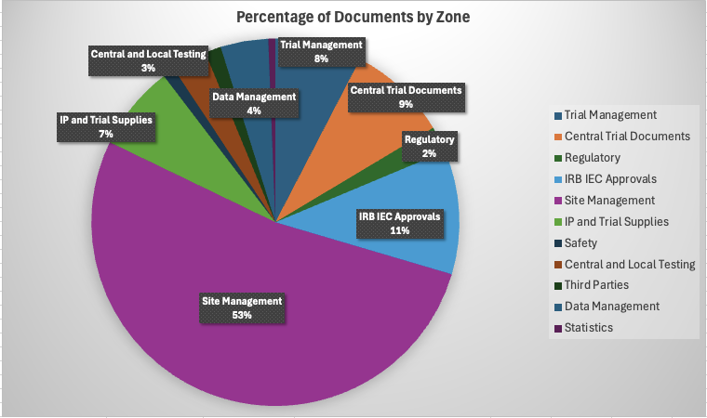
Data Trend #1: Document Creation by Zone

Slide 18
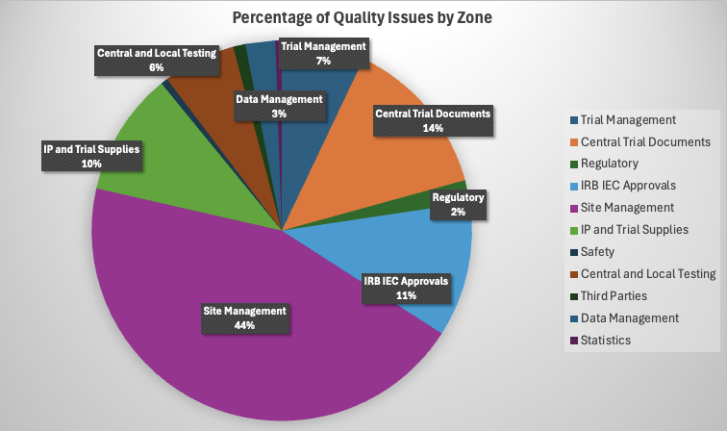
Data Trend #2: Percent of Quality Issues

Slide 19
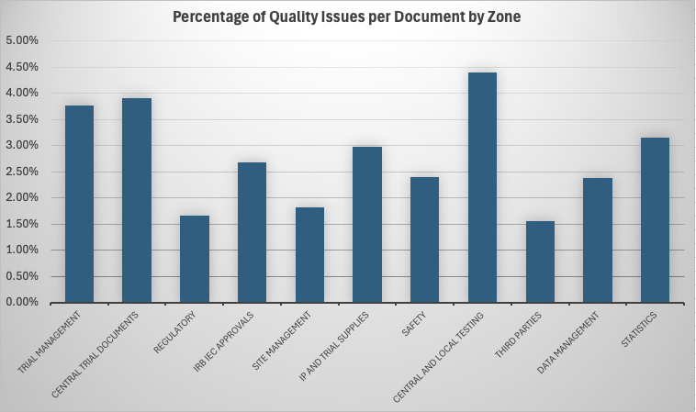
Data Trend #2: Percent of Quality Issues Relative to Total Docs

Slide 20
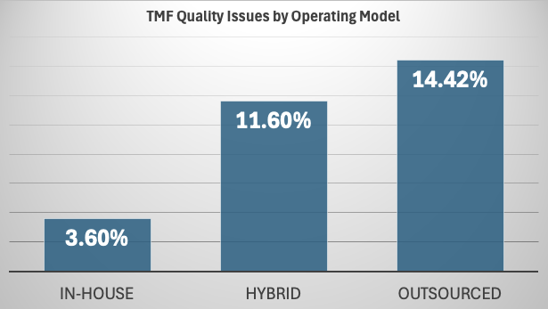
Data Trend #3: In-House vs. Outsourced – TMF Quality

Slide 21
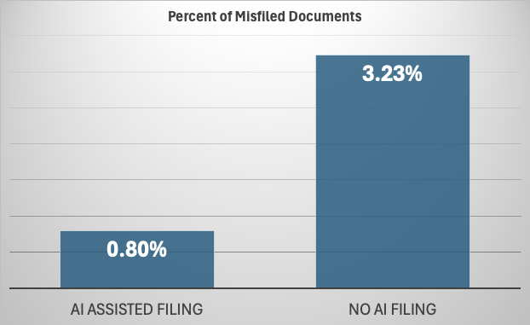
Data Trend #4: AI and Misclassifications

Slide 22
Thank You!

