Slide 1
FDA-CTP and CDISC Develop Tobacco Data Standards to Achieve Efficiencies for All Stakeholders
Presented by
Chrissie Cai
Data Quality Management Team Supervisor
DRSI, OS, CTP, FDA
Presented by
Christine Connolly
Head of Standards Projects, CDISC
09 July 2023

Slide 2
the tobacco control act became law on June 22, 2009
To regulate tobacco products and ensure that FDA had the authority to address issues of concern, especially tobacco dependence and the use of tobacco by young people – Congress passed the Tobacco Control Act
FDA’s goal is to reduce the harm from all regulated tobacco products across the entire U.S. population:
Reducing the number of people who start using tobacco products
Encouraging more people to stop using these products
Reducing the adverse health impact for those who continue to use these products

Slide 3
The tobacco control act’s authorities
The Tobacco Control Act amended the Federal Food, Drug, and Cosmetic Act (FD&C) to provide FDA authority for:
Premarket review of new and modified risk tobacco products
Postmarket surveillance
Product standards
Testing and reporting of ingredients
Reporting of harmful and potentially harmful constituents
Adverse event reporting
New warning labels
Advertising and promotion restrictions
User fees

Slide 4
FDA’s tobacco Regulatory authorities
In general, FDA’s tobacco regulatory authorities do not extend to:
Setting tax rates for tobacco products
Regulating therapeutic products, such as those marketed to treat tobacco dependence (regulated by other parts of FDA)
Setting clean indoor air policies
Regulating tobacco growing
Requiring the reduction of nicotine yields to zero
Providing cessation services
Banning all cigarettes, smokeless tobacco products, little cigars, other cigars, pipe tobacco, or roll-your-own tobacco products
Changing the minimum age of sale for tobacco products

Slide 5
About CTP
Vision Statement
To make tobacco-related death and disease part of America's past, not America's future and, by doing so, ensure a healthier life for every family
Mission Statement
To protect Americans from tobacco-related death and disease by regulating the manufacture, distribution, and marketing of tobacco products and by educating the public, especially young people, about tobacco products and the dangers their use poses to themselves and others
Key Strategic Priorities
Product Standards
Comprehensive FDA Nicotine Regulatory Policy
Pre & Post-Market Controls; Regulations & Product Reviews
Compliance and Enforcement
Public Education

Slide 6
CTP and Data Standards
CTP Data Standards Strategy 2021-2025
Purpose: Strategies for the development and dissemination of data standards to better support the programs of CTP through better, more meaningful data
Areas that are included
Electronic Data Exchange Standards
Premarket and Postmarket Review
Quality
Policy
Planning and Governance

Slide 7
CTP and Data Standards
Electronic Data Exchange Standards
Technical Specification Document
Electronic Submissions through CTP Portal or Electronic Submission Gateway (ESG)
Utilize the Appendix A example for Organization of Folders and Documents
Electronic submissions must be packaged using eSubmitter
Data files such as Excel (xls, xlsx) or sas transport files (xpt or xport) should not be converted to a PDF
Best Practices
Obtain an Industry Account Manager account for CTP Portal
Submit applications electronically utilizing eSubmitter and CTP Portal
Follow recommendations in the Technical Specification Document
Future State
Functionality and/or tools to assist submitters in organizing and packaging submissions
Validations built into tools to assist submitters in correcting issues prior to submission

Slide 8
CTP and Data Standards
Premarket and Postmarket Review
OMB Forms
Required forms for Premarket Tobacco Product Application and Substantial Equivalence Applications were released when the rules were published 10/4/2021 and the supporting OMB Forms were published in January 2022
Form 4057b: Product Application Grouping Spreadsheet is utilized to standardize product information contained within a submission until such time that a data standard is available
Similar forms are forthcoming for Substantial Equivalence and Exemption applications
Best Practices
Always obtain the most recent form from FDA.gov. Do not re-use previously downloaded forms
Submit 4057b with all PMTA applications
Complete the required fields defined by product category and sub-category
Do NOT change form fields, data drop downs or file format. Submit the file as an .xlsx
Future State
Evaluating development of tools to assist submitters in populating form prior to submission

Slide 9
CTP and Data Standards
CTP DATA STANDARDS GRANT PROGRAM
The Grant program has published for public participation under RFA-FD-22-002
This is a Cooperative Agreement grant which is a support mechanism used when there will be substantial Federal scientific or programmatic involvement. Substantial involvement means that, after award, FDA scientific or program staff will assist, guide, coordinate, or participate in project activities.
THE GRANTEE IS THE LEAD
Outlines CTP Data Standards Program strategic goals
Support open, consensus-based, data standards development
Maintain and promote a well-defined data standards governance function,
Promote electronic submission of regulatory data using established standards
Optimize CTP’s regulatory review process to fully leverage data conformed to standards

Slide 10
CTP and Data Standards
Benefits to Industry
Reduces time for reviewers to locate and identify required documents
Validations can be built into the portal and/or packaging tools to assist Industry in submitting the necessary information required for a particular submission
Standardized structured data allows for validation criteria to be built into tools
Aligns CTP with FDA Data Standards Catalog in the use of data standards and supporting tools
Standardized data helps CTP to streamline the review process by organizing files and data and enabling search and automation capabilities
Controlled terminology ensures that the same words mean the same thing to both industry and FDA.
Improves collaboration and communication between FDA and Stakeholders
FDA leverages form data to obtain administrative information, help determine review types, and populate databases to enable the use of technology for review and analysis

Slide 11
Tobacco implementation guide (tig)
Tobacco Implementation Guide (TIG):
Supports the CTP Data Standards Strategy 2021-2025 through provision of standards and terminologies to facilitate tobacco research, scientific review, harm reduction, and information exchange
Is a collaborative initiative with FDA-CTP, CDISC, and industry stakeholders
To develop non-proprietary, consensus-based, vendor-neutral, platform-independent submission data standards for tobacco product data
Will develop a set of standards, collectively referred to as TIG v1.0, to be freely available on the CDISC website with publication planned in 2023

Slide 12
Tobacco implementation guide (tig) v1.0
A single, comprehensive implementation guide designed for use cases unique to tobacco studies
An overview of standards and general implementation
With guidance by topics and use cases; e.g.
Key scientific concepts and maps
Data Collection
(CDASH eCRFs,
ODM-XML)
Data Tabulation
(SEND, SDTM Human Clinical, Define-XML)
Analysis
(ADaM, Define-XML)
Product Description
Nonclinical
Individual Health
Population Health
Common Language (Controlled Terminology)
Measures of Adherence (Conformance Rules)
Accessible in platforms which optimize use (including CDISC website, CDISC Library)
Accessible in platforms which optimize use (including CDISC website, CDISC Library)
Education and Outreach (including webinars, formal training)

Slide 13
Data standards
Addresses concepts for tobacco studies and translates them into CDISC standards for both:
Established CDISC standards
New CDISC standards to fill gaps identified by FDA-CTP and Industry SMEs
Standards you will see as part of this project include:

Slide 14
TIG Team and timelines
FDA-CTP
~ 5 Disciplines
~ 34 Members
CDISC
Industry
~ 10 Companies
~ 37 Members
Internal Review comment resolution

Slide 15
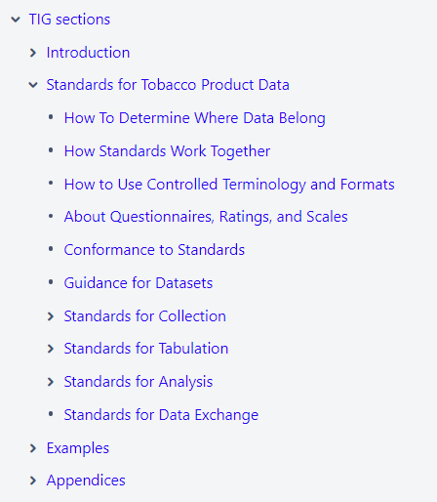
progress
Draft
Scope and Requirements for TIG v1.0 are complete
Key concepts are identified
Standards development is complete via four workstreams
Internal Review comment resolution is in progress
Data Science strategy/platforms are in progress
Education & Communication started; training development in progress
Conference presentations in 2022 and 2023 to raise awareness

Slide 16
INNOVATION Highlights
The TIG v1.0 is CDISC’s first hybrid implementation guide.
Developed in partnership with the FDA-CTP, the TIG v1.0 is a stand-alone CDISC foundational standard that serves as a comprehensive resource for the collection, tabulation, analysis, and exchange of tobacco product data for submissions to FDA-CTP.
The TIG v1.0 implements the following models:
CDASH Model v1.2
SDTM v2.1
ADaM v2.1
With references to standards and resources including Define-XML v2.1 and CDISC eCRF Portal

Slide 17
Hybrid implementation guide strategy
Philosophy for development:
Adhere to Plain Writing: It's the Law! | FDA
https://www.plainlanguage.gov/guidelines/, as much as possible
Orient implementation guide to 1) Data, 2) Users, and 3) Standards - in this order
Ensure guidance is simplified, concise, and organized from highest level concepts to detailed concepts
Adhere to scope of implementation of standards only (i.e., like an instruction manual)
Limit content related to:
Historical or theoretical topics better covered in CDISC Knowledge Base articles, glossaries, and/or training
Regulatory requirements that are defined and managed by FDA-CTP
Guidance for using external standards, e.g., ISO 8601, best covered by the external organization
Suggested in team kick-off.

Slide 18
Innovation highlights
The TIG v1.0 focuses on implementation for use cases inherent to tobacco product data comprised of concepts identified by one or more stakeholders as important in the context of tobacco product research.
Draft

Slide 19
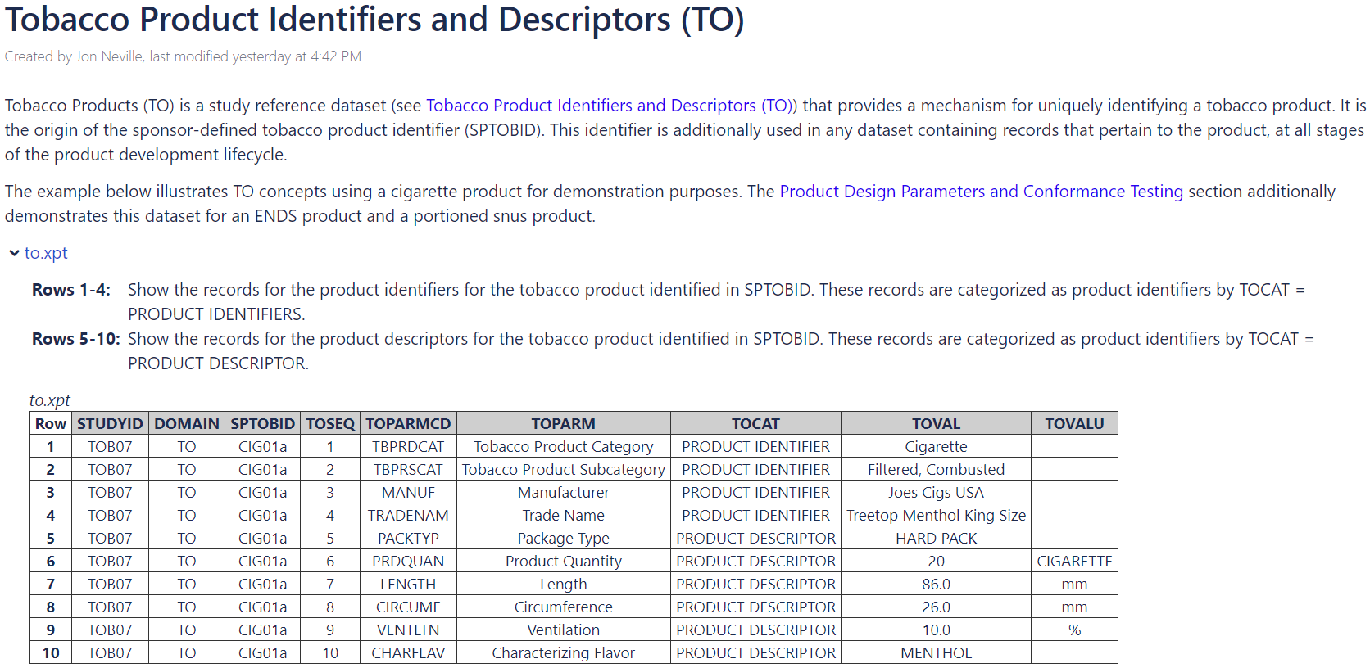
Product description example
Draft

Slide 20
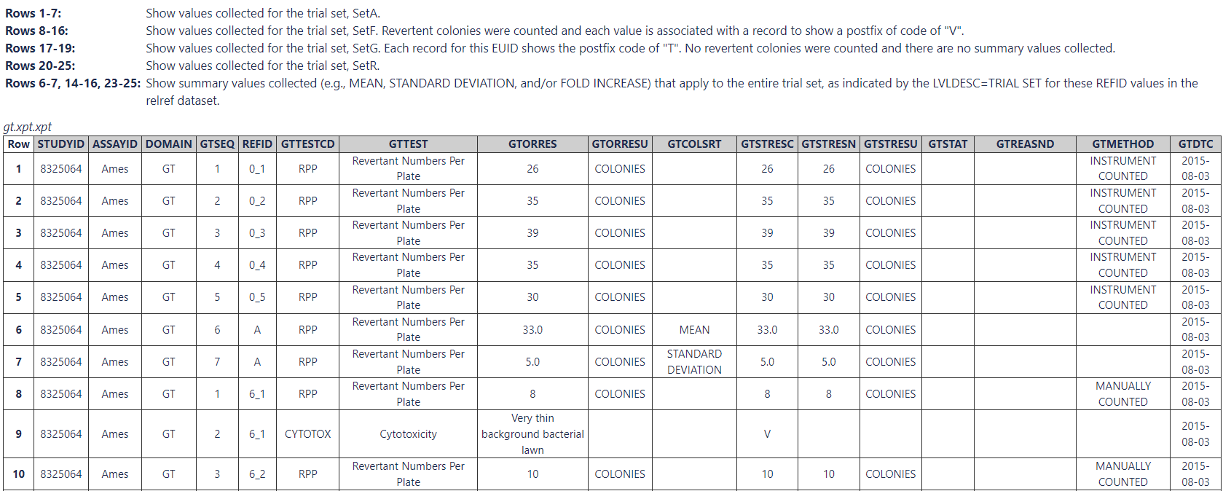
Nonclinical in vitro example
Draft

Slide 21
Data science innovation
CDISC Library
End-to-end standards for tobacco studies
Inclusion of informative content (e.g., domain assumptions and examples)
Biomedical Concepts available
ODM-XML representations of case report forms

Slide 22
How you can be involved
We invite you to contribute to development of TIG standards.
Become a Tobacco Implementation Guide (TIG) volunteer
www.cdisc.org/volunteer
Click link to Become a Volunteer
Time commitment is generally a one-hour weekly meeting
It is never too late to volunteer.
Review draft standards as they are released
Please reach out with any questions or support you may need.
Christine Connolly, CDISC Head of Standards Projects: cconnolly@cdisc.org

Slide 23
Thank you
We welcome your questions and feedback!

